Slide 1
Loan Application Digitization Solution
Scenario Overview
Problem
Manual paper-based loan applications
High processing time and risk of errors
Limited tracking and analytics
CIBC Consultant Interview
Candidate: Atsu Vovor
Objective
Digitize loan applications using Power Platform,
Automate validation, notifications, and approvals
Provide real-time dashboards for insights
Role: Consultant – Automation & Analytics
Date: 02/03/2026
Data Sources
Dataset: Loan App Data.csv
50 sample applications with fields like ID, Customer Name, Loan Amount, Status, Attachments
Sample PDF: Sample Application.pdf
Contains personal details, loan requested, supporting documents, and approver info

Slide 2
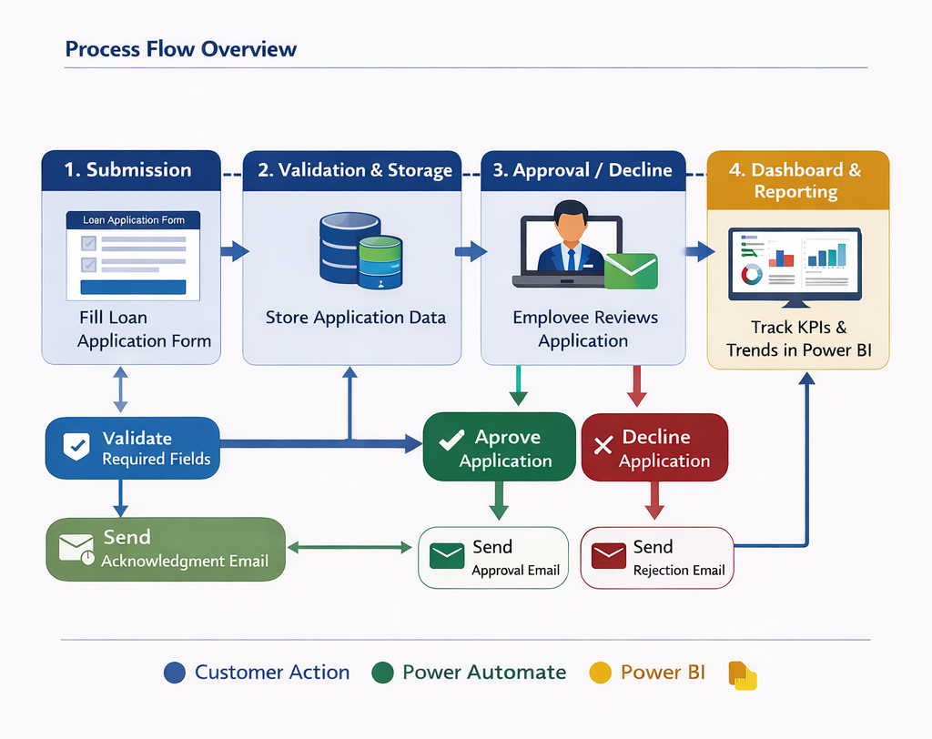
Proposed Power Platform Solution
Assumptions Made
Security
External customers only have access to their own records via the Portal, while Employees have global read/write access.
Environment:
The solution will be housed in a Production Environment with Dataverse capacity enabled.
Migration
Historical data from the Loan App Data.csv will be bulk-imported using the Dataverse "Import from Excel" tool during deployment.

Slide 3
System Architecture
Solution Overview
Data Layer (Dataverse)
A relational database hosting the Loan Application table. This includes all fields from the CSV (e.g., APP001) and the PDF (e.g., Loan Term, Address).
Intake Layer (Power Apps)
A Canvas App for customers to submit details and upload "ID" and "Proof of Income" documents.
Automation Layer (Power Automate)
* Acknowledgment Flow: Sends instant emails upon submission.
Approval Flow: Routes requests to "Officer 1" (D J Tram).
Review Layer (Power Pages)
A secure portal for bank employees to manage the queue and update application statuses.
Analytics Layer (Power BI)
A dashboard tracking Approval Rates and Processing Times.

Slide 4
Data Sources Data Gap Analysis & Schema Alignment
Reconciling "Sample Application.pdf" with "Loan App Data.csv"
Field Name | Found in CSV? | Found in PDF? | Implementation Action
Application ID | ✅ | ✅ | Primary Name Column: Set as Autonumber (e.g., APP-0000).
Customer Name | ✅ | ✅ | Text Columns: Create separate First Name and Last Name to match PDF structure.
Loan Amount | ✅ | ✅ | Currency Column: Minimum/Maximum values set for validation.
Status | ✅ | ❌ | Choice Column: Options: Submitted, Under Review, Approved, Rejected.
Address | ❌ | ✅ | Text Area Column: Multiline text to capture full address details.
Loan Term | ❌ | ✅ | Choice Column: Dropdown with values (e.g., 1 yr, 3 yrs, 5 yrs).
Interest Rate | ❌ | ✅ | Decimal Column: Precision set to 2 decimal places (Percentage).
Approver Name | ❌ | ✅ | Lookup Column: Link to the Users table for internal accountability.
Approver Position | ❌ | ✅ | Text Column: Captures the title of the reviewing officer (e.g., Officer 1).
Application Date | ✅ | ✅ | Date Only Column: User Local behavior; Defaults to Created On.
End Date | ✅ | ✅ | Date Only Column: Populated via Flow when status changes to Final.
Document Provided: ID | ✅ | ✅ | File Column: Specifically for ID upload; restricted to image/PDF.
Document Provided | ✅ | ❌ | Choice/Multiselect: Captures types (e.g., Proof of Income, Tax Returns).
Signature | ❌ | ✅ | Image Column: Enabled for "Pen Input" in the Canvas App/Portal.

Slide 5
Dataverse Table Schema
Dataverse Table: Loan Application - Display Name: Loan Application
Primary Column: Application ID (crxxx_applicationid)
Logical Name | Display Name | Data Type | Implementation Notes
crxxx_applicationid | Application ID | Autonumber | Prefixed with "APP-". Acts as the primary key.
crxxx_firstname | First Name | Text | Mandatory field for intake.
crxxx_lastname | Last Name | Text | Mandatory field for intake.
crxxx_loanamount | Loan Amount | Currency | Set with validation: Min 0, Max 1,000,000.
crxxx_status | Status | Choice | Local Choice: Submitted (Default), Under Review, Approved, Rejected.
crxxx_address | Address | Plain Text | Multiple lines enabled to capture full address from PDF.
crxxx_loanterm | Loan Term | Choice | Options: 1 Year, 3 Years, 5 Years, 10 Years.
crxxx_interestrate | Interest Rate | Decimal | Precision: 2; allows for values like 5.25%.
crxxx_approver | Approver Name | Lookup | Links to the SystemUser table for internal security.
crxxx_approverpos | Approver Position | Text | Captures "Officer 1" as seen in the sample.
crxxx_appdate | Application Date | Date Only | Behavioral: User Local.
crxxx_enddate | End Date | Date Only | Automated: Stamped when Status = Approved/Rejected.
crxxx_idupload | ID Document | File | Restricted to 10MB; supports .pdf, .jpg, .png.
crxxx_docsprovided | Docs Provided | Choices | Multi-select: ID, Proof of Income, Tax Returns.
crxxx_signature | Signature | Image | Stored as a "Primary Image" to support Pen Input controls.

Slide 6
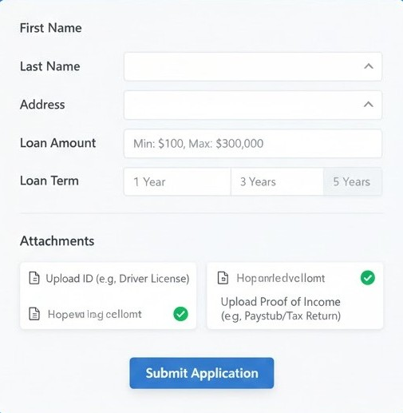
Data Capture: PowerApps Form(Client)
ntake & Validation (Power Apps)
I will build a Canvas App for mobile and tablet use by customers.
Form Design: Includes fields for Personal Details, Loan Amount (e.g., $50,000), and a Loan Term dropdown.
Validation: Logic added to the "Submit" button: If(IsBlank(DataCardValue), DisplayError).
Attachments: An "Add Attachment" control specifically mapped to "ID" and "Proof of Income" requirements.

Slide 7
Workflow Automation
Power Automate
A. Customer Validation
The Canvas App will use Power Fx to ensure no empty applications are sent:
DisplayMode: If(IsBlank(DataCardValue_Amount.Text), DisplayMode.Disabled, DisplayMode.Edit)
B. Automated Acknowledgment
Trigger: Dataverse – When a row is added.
Action: Send an email (V2).
Dynamic Content: "Dear [Customer Name], your application [App ID] for [Amount] has been received."
C. Approval Process
Step 1: Application enters "Under Review" status.
Step 2: Approver (D J Tram) receives a notification.
Step 3: Upon Approval/Rejection, the End Date is automatically updated via the flow

Slide 8
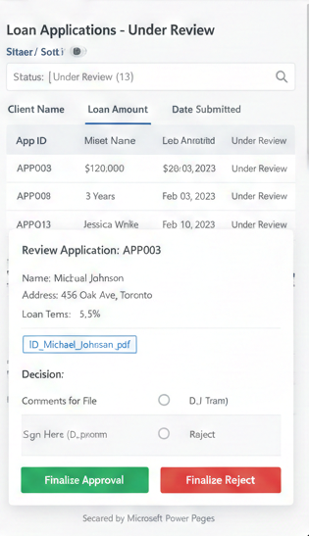
Employee Review Portal (Power Pages)
Step C: Employee Review Portal (Power Pages)
A secure Power Pages Portal will be created for bank employees:
Queue Management: Employees can filter by "Submitted" or "Under Review" status.
Decision Engine: Buttons to "Approve" or "Reject." Upon approval, the "End Date" is automatically stamped with the current date to track processing time.

Slide 9
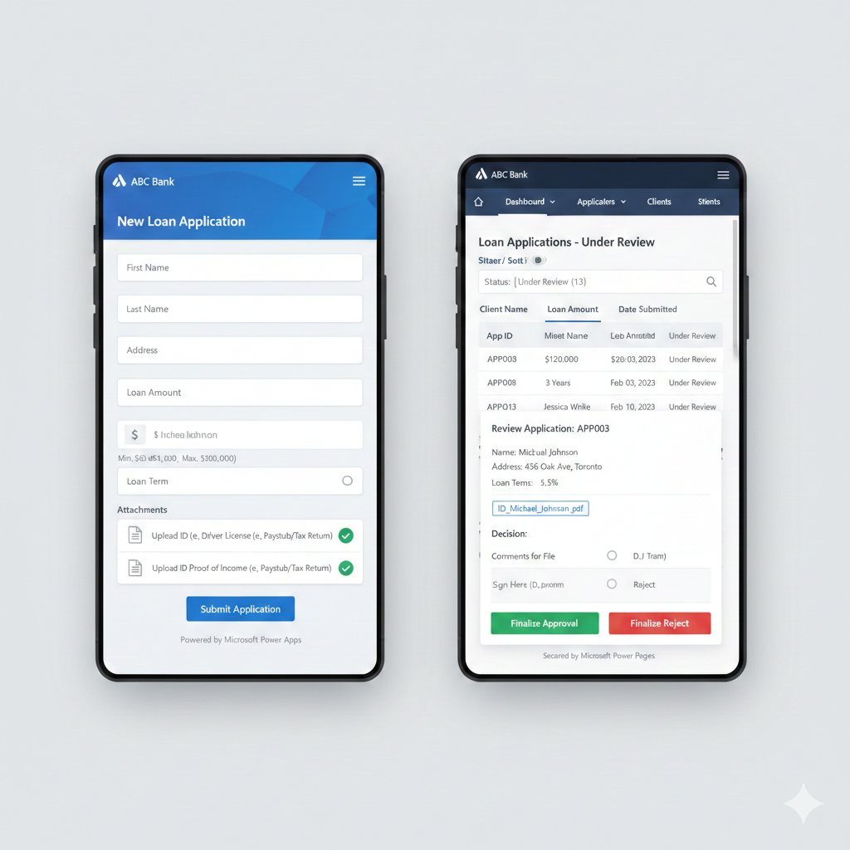
Loan Application Frontend Mobile Application Forms
2
70%

Slide 10
Data Integration
2
Import the CSV data into Dataverse as initial dataset.
Use Power Automate to parse PDFs for incoming applications (optional OCR for ID/Proof of Income).
70%

Slide 11
Loan Application Management Dashboard
Power BI Dashboard
2
Visuals:
Bar chart: applications by status.
Line chart: monthly application trends.
Pie chart: loan approval vs rejection.
Donut chart: Attachments Verification Rat
Metrics to track:
Total applications, approved, rejected, under review.
Average processing time: End Date - Application Date.
Loan trends: total loan amount per month, approval rate per loan amount range.
Attachments verification rate.
70%

Slide 12
Top KPI Summary Row (Cards Section)
op KPI Summary Row (Cards Section)
Place 5 KPI cards horizontally across the top:
Power BI Executive View
2
KPI | Description | DAX Logic
Total Applications | Count of all applications | COUNT(Application ID)
Approved | Count where Status = Approved | CALCULATE(COUNT(ID), Status="Approved")
Rejected | Count where Status = Rejected | CALCULATE(COUNT(ID), Status="Rejected")
Under Review | Count where Status = Under Review | CALCULATE(COUNT(ID), Status="Under Review")
Avg Processing Time (Days) | End Date – Application Date | AVERAGE(DATEDIFF(Application Date, End Date, DAY))
70%
Design Tip:
Use green for Approved Red for Rejected Orange for Under Review Neutral blue for totals

Slide 13
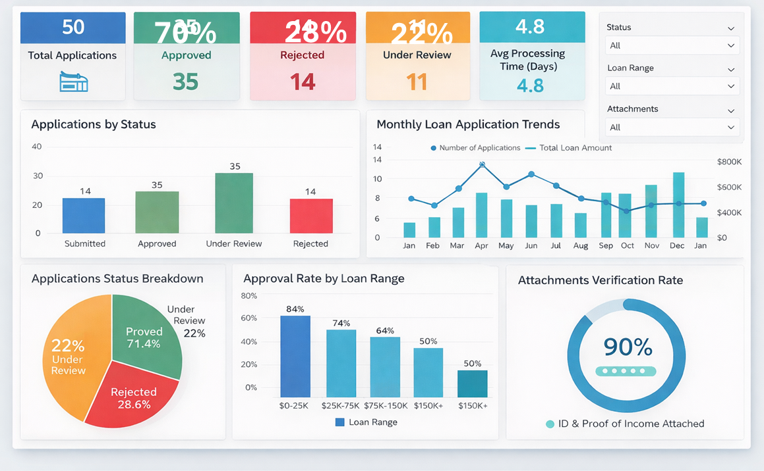
Sample Dashboard
Power BI Dashboard
70%

Slide 14
Workflow Summary
2
Customer submits application via Power Apps form.
System validates required fields.
Automatic acknowledgment email is sent.
Application enters Pending Approval queue in portal.
Bank employee approves/rejects in portal.
Application status updated, final email sent to customer.
Dashboard automatically updates metrics.
70%

Slide 15
Final Assumptions
Digital Signatures: It is assumed that the physical signature "+())((&*&" will be replaced by an authenticated Power Platform digital signature.
Environment: The solution assumes a Power Apps per-user license is available for the 50 initial records and future growth..

Slide 16
Optional Enhancements
Integrate Power Virtual Agent chatbot for customer queries.
Use AI Builder to extract fields from uploaded PDF (e.g., loan amount, customer name).
Set up alerts for high-value loans

Slide 17
Future Power BI Pages Implementation
2
Executive Summary
Loan Applications
Loan Approval Analysis
Loan Trends Customer Analysis
Branch Performance
Employee Reviews
70%

